Slide 1

USDA | Identifying Capstone Officials
TEAM: IC25075
TRACKSMART
Automated Identification and Compliance Tracking System for Federal Capstone Officials
Team Members:
1.) Jiten Bhalavat
2.) Shyam Solanke
3.) Suhani Singh

Slide 2
Objective: Efficiently identify and track Capstone Officials in federal agencies for records management compliance.
Dual-Pathway Approach:
Unstructured Data (PDFs, Emails, Documents): Uses Qdrant (vector database) for semantic search and extraction of Capstone designations.
Structured Data (HR Exports, Org Charts, Spreadsheets): Uses Neo4j (graph database) to track positional changes and reporting structures.
AI Verification: Cross-checks extracted data with official government sources to validate affiliations, emails, and positions.
Key Benefits:
Detects temporary Acting roles often missed in HR systems.
Reduces manual effort, enhances accuracy, and ensures compliance.
Provides a comprehensive audit trail for records management.
Unstructured Data
Structured Data
AI Agents

Slide 3
UseCases (Solved):
Identify capstone roles: capstone or not
Locate unknown personnel, start/end dates, emails, agency, role serving in capstone roles.
Matching it against roles we know are approved.
Associate each capstone role with an agency.
Check name against existing list, validate names, email address, etc. against existing list.

Slide 4




Dual-Pathway Methodology
Data Source Identification
The process begins by categorizing agency data into structured sources (HR exports, org charts, spreadsheets) and unstructured sources (PDFs, emails, meeting minutes) to determine appropriate processing paths.
Parallel Processing
Both data pathways operate simultaneously, with unstructured data flowing to vector database processing while structured data enters the graph database architecture.
Integration & Verification
Results from both pathways are consolidated and verified through an AI agent system that conducts automated checks against authoritative government sources for complete data integrity.

Slide 5
But,
What’s The AI Solution ??

Slide 6
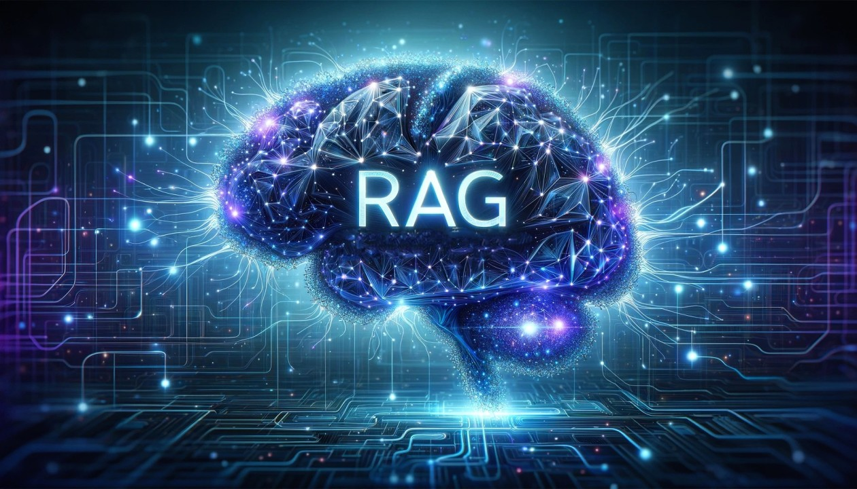

Slide 7
Wait, What’s RAG ?
Imagine this:
You have a 1000-page Biology book in front of you. You want to know about something specific, like "What is a microorganism?"
Now, if you already know where to find that information, you can quickly flip to the right page and get your answer.
But what if someone else doesn’t know where to look? They would have to go through the entire book, page by page, which would take hours!
That’s where Retrieval-Augmented Generation (RAG) comes in.
Instead of searching through the whole book, RAG acts like a super-efficient helper. You ask a question, and RAG quickly searches the entire book for the relevant information and then generates the answer in seconds, without you needing to flip through every page.
So, with RAG, the answer is right at your fingertips, fast and accurate!

Slide 8
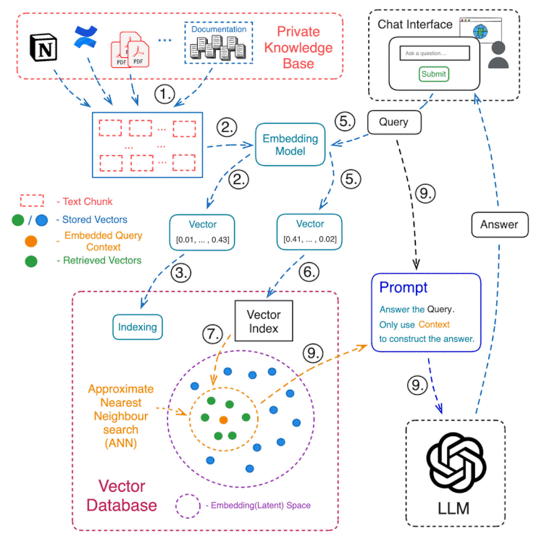
SO,
HOW BASICALLY
RAG WORKS ??

Slide 9




Unstructured Data Processing
Document Ingestion
Vector Embedding
PDFs, emails, and text documents are collected and converted to machine-readable formats.
Qdrant vector database transforms content into high-dimensional vectors that capture semantic meaning.
1
2
Semantic Search
Entity Extraction
Natural language processing identifies Capstone-related information including Acting designations in meeting minutes and email signatures.
AI algorithms extract names, positions, dates, and organizational affiliations for potential Capstone Officials.
4
3

Slide 10

For Structured Data, Semantic Search Between Data Doesn’t Work

Slide 11
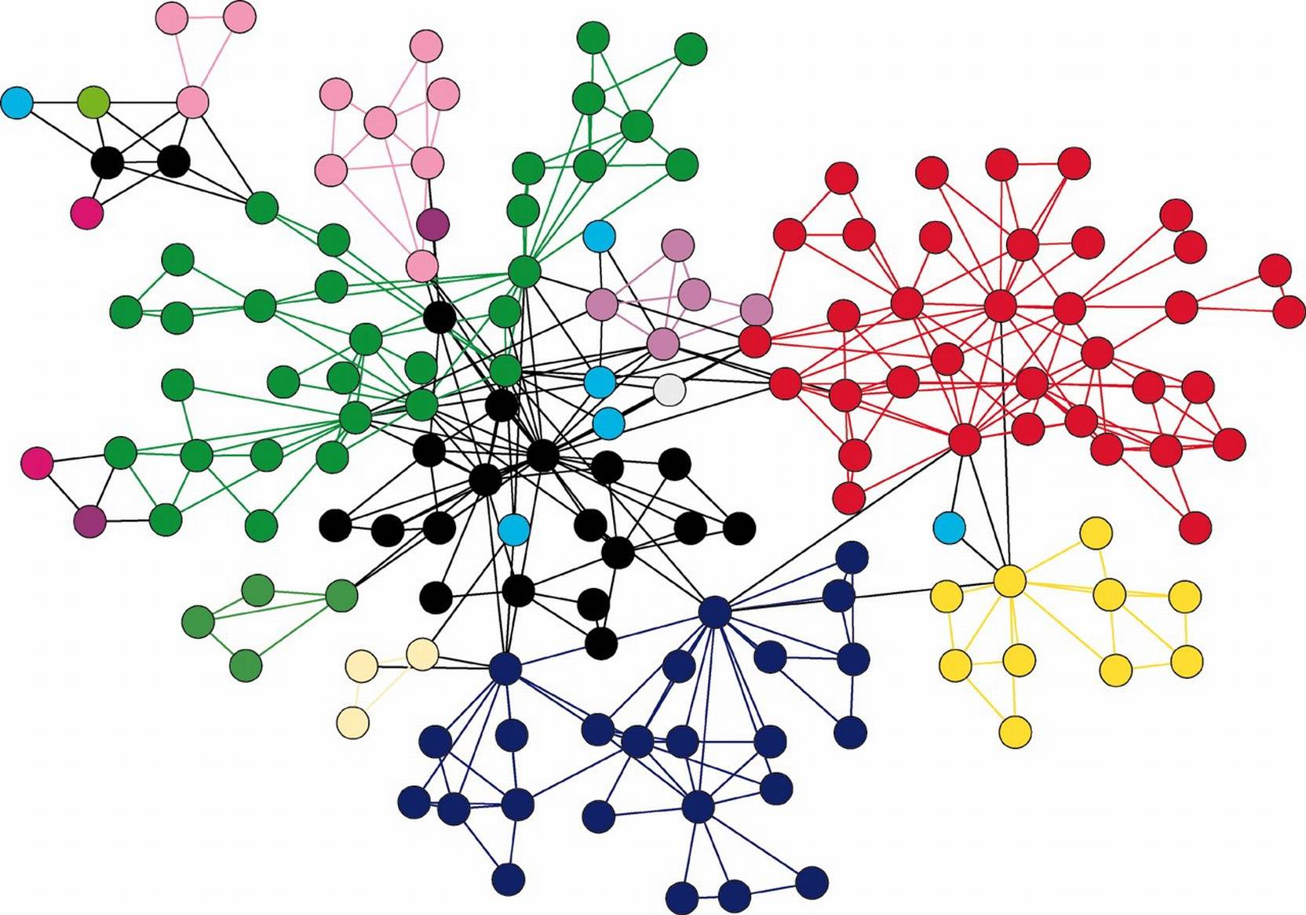
So, what’s next?
GRAPH DATABASE

Slide 12
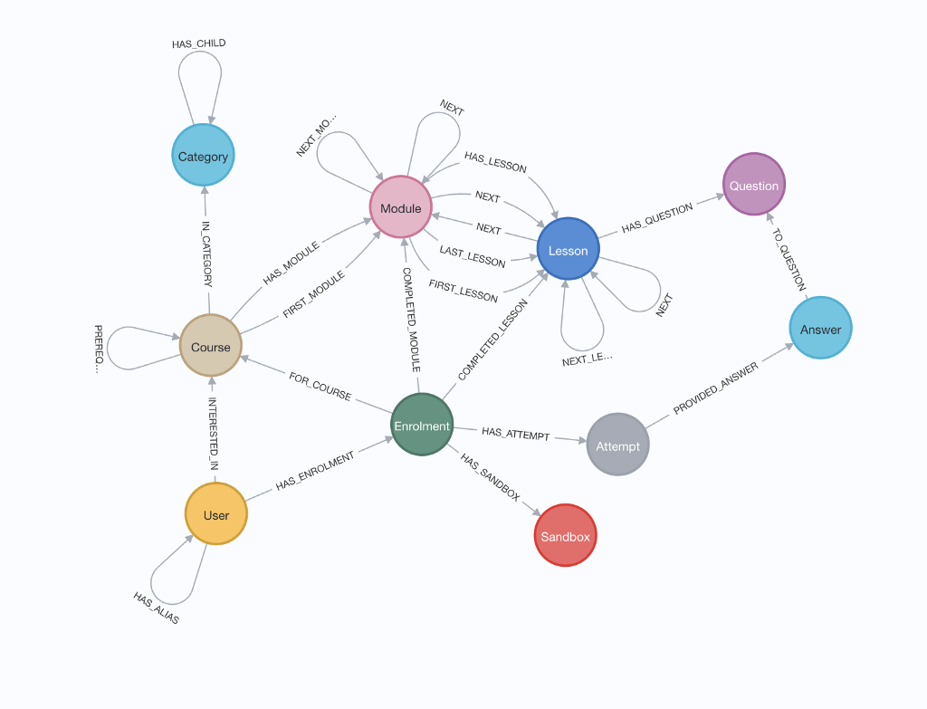
WHAT
IS
GRAPH DATABASE ????

Slide 13
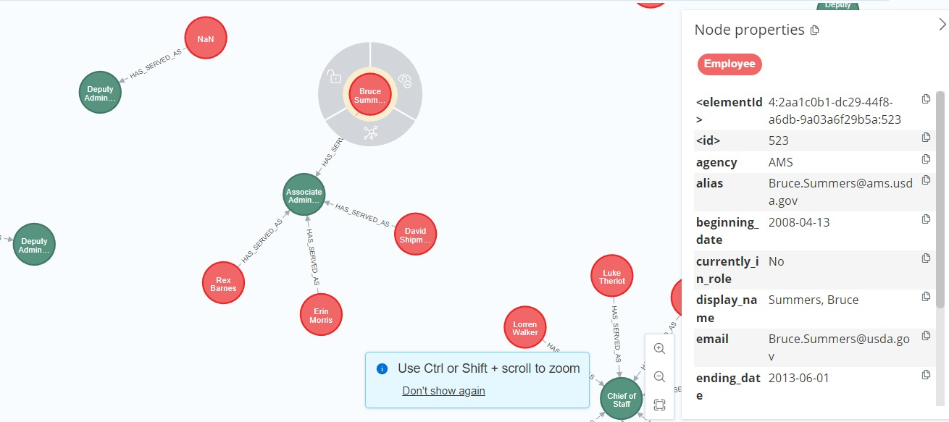
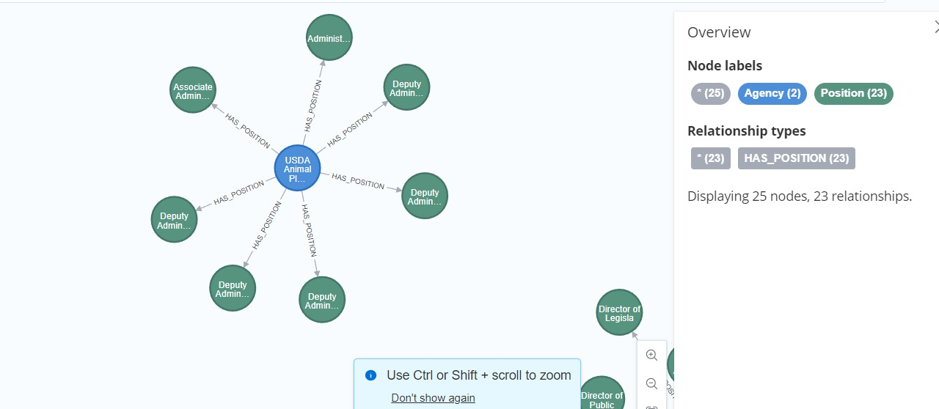
EXAMPLES

Slide 14
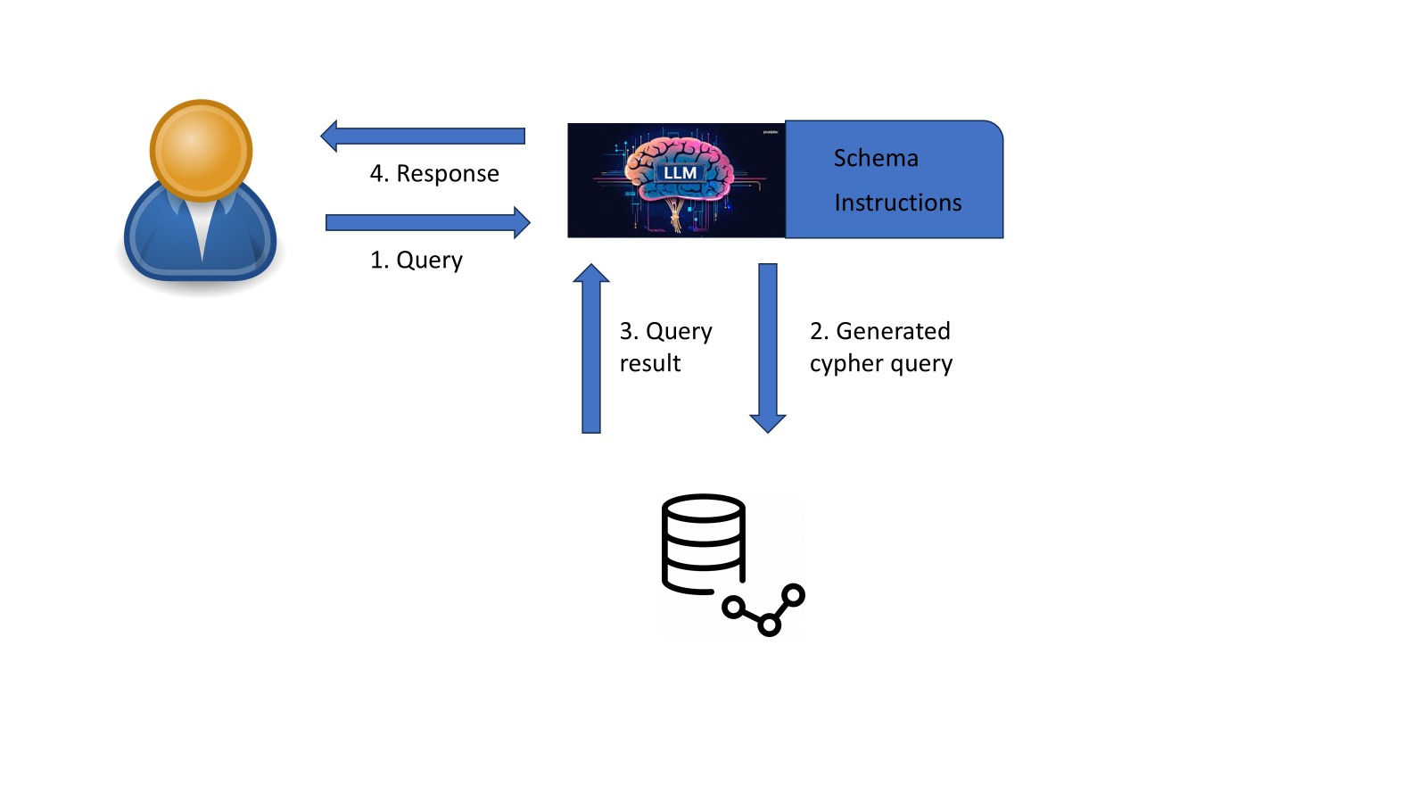
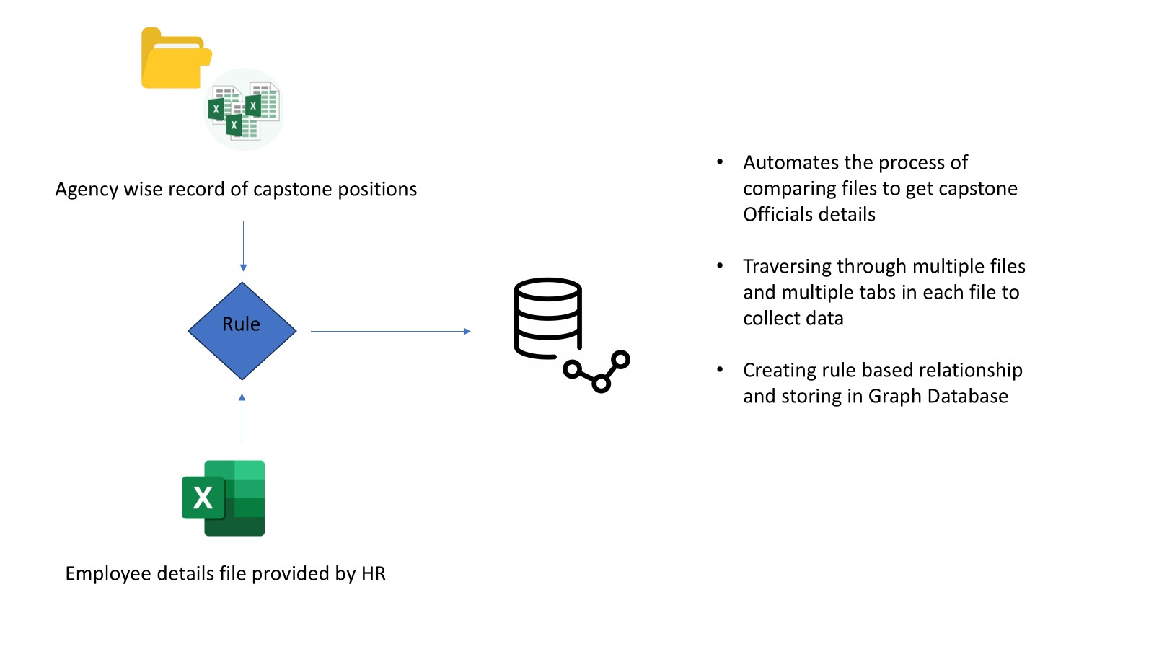
HOW ?

Slide 15
AND…

Slide 16

WHAT
Are
These
AI
AGENTS
????

Slide 17

AI Verification System
Cross-Reference Automation
AI agents automatically query official government websites, directories, and public databases to confirm the identity and position of identified Capstone Officials.
Email Validation
System verifies official email addresses and domains to ensure individuals are correctly associated with appropriate federal agencies and departments.
Position Confirmation
Automated checks compare extracted position information against authoritative sources to validate hierarchical level and Capstone eligibility.
Temporal Tracking
The system maintains historical records of position changes, including start and end dates for Acting roles, creating a comprehensive timeline for each Capstone position.

Slide 18

Key Benefits & Results
Time Reduction
Accuracy Rate
The hybrid model reduces manual processing time by automating identification and verification tasks that previously required extensive human review.
Combined verification through dual pathways and AI validation ensures near-perfect identification of Capstone Officials, significantly exceeding manual processes.
Compliance Coverage
The system provides comprehensive audit trails and documentation for all identified Capstone Officials, ensuring full regulatory compliance and simplified reporting.

Slide 19


Slide 20


Slide 21
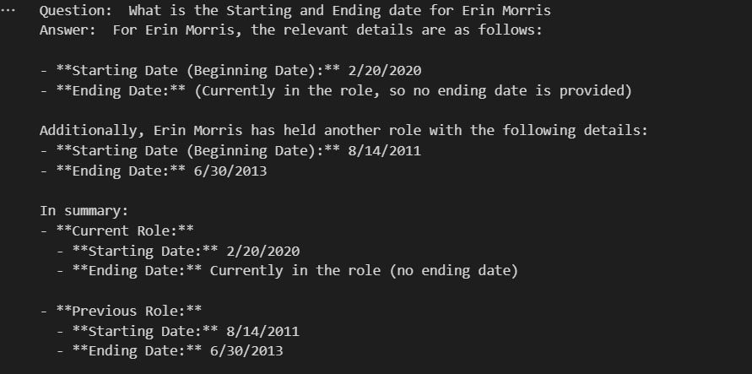
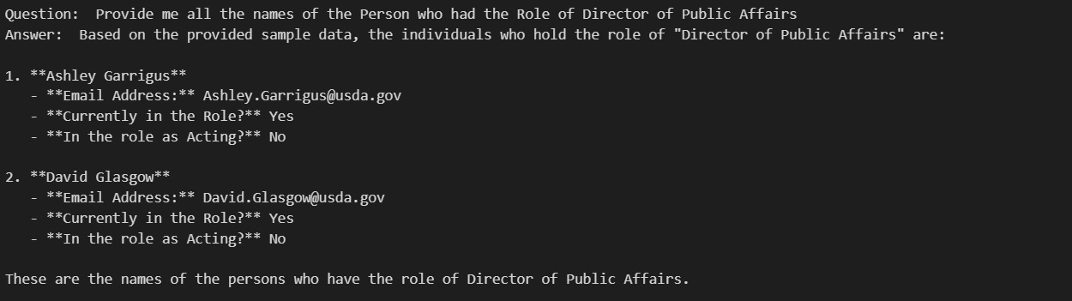

Slide 22
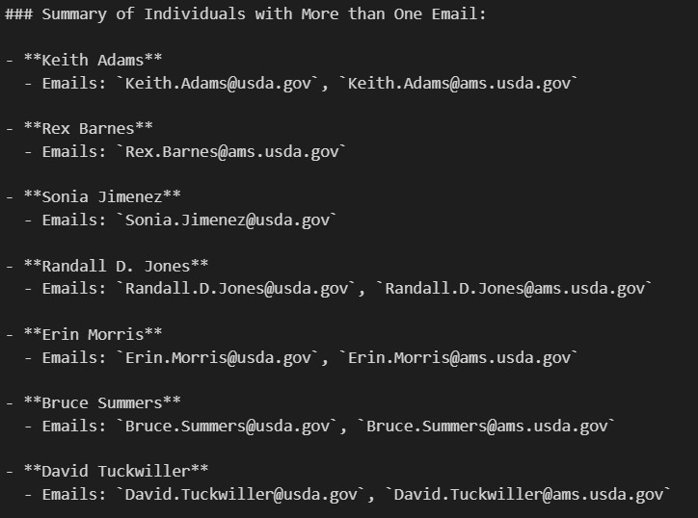
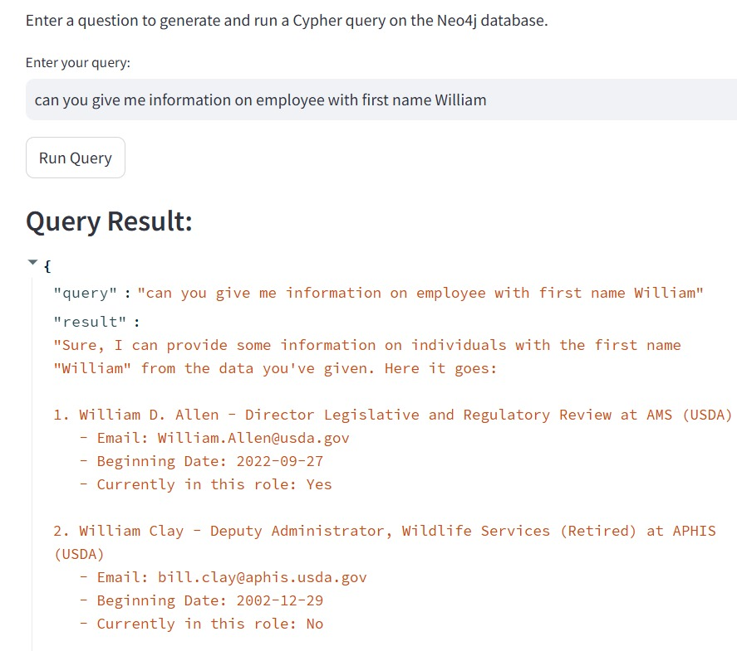

Slide 23
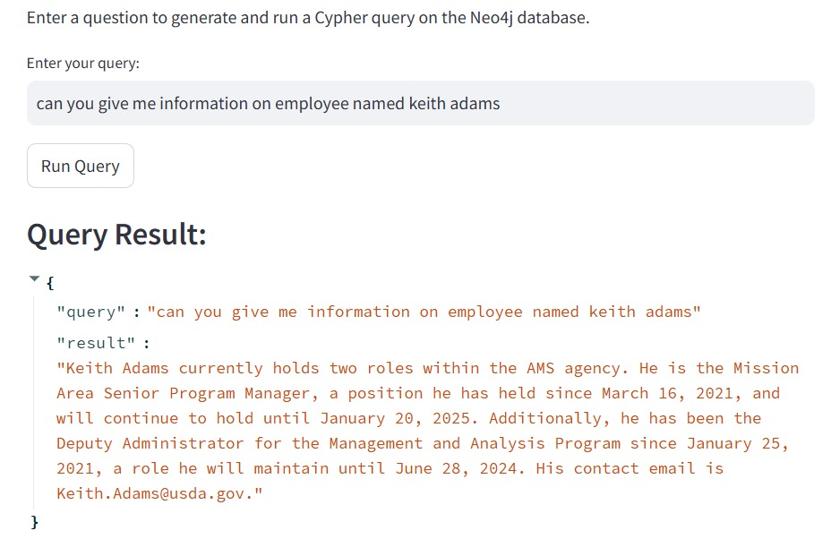
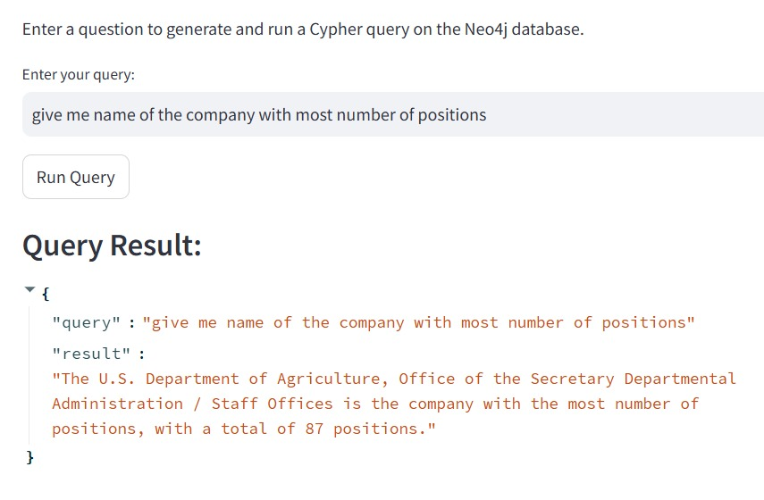

Slide 24
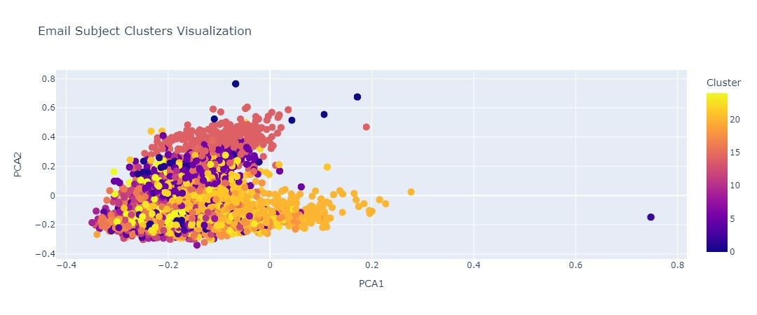


Slide 25
Thank you for your time and attention during my presentation.

